Slide 1

Programming Two (csc7051)
Aidan McGowan
Sorting
Bubble sort
Selection sort
Insertion sort
Quick sort

Slide 2
Sorting
Sorting data (i.e., placing the data into some particular order, such as ascending or descending) is one of the most important computing applications.
    A bank sorts all checks by account number so that it can prepare individual bank statements at the end of each month.
    Telephone companies sort their lists of accounts by last name and, further, by first name to make it easy to find phone numbers. Virtually every organisation must sort some data, and often massive amounts of it.
Sorting data is an intriguing, computer-intensive problem that has attracted intense research efforts.

Slide 3
Sorting algorithms
An important item to understand about sorting is that the end result—the sorted array—will be the same no matter which algorithm you use to sort the array. The choice of algorithm affects only the run time and memory use of the program.
Bubble sort, Selection sort and Insertion sort—are easy to program but inefficient.
Quick sort is faster than selection sort and insertion sort but harder to program.

Slide 4

Sorting an array – bubble sort
In the bubble sort, as elements are sorted they gradually "bubble" (or rise) to their proper location in the array, like bubbles rising in a glass.
The bubble sort repeatedly compares adjacent elements of an array. The first and second elements are compared and swapped if out of order. Then the second and third elements are compared and swapped if out of order.
This sorting process continues until the last two elements of the array are compared and swapped if out of order.
Notes:
http://www.youtube.com/watch?v=8Kp-8OGwphY

Slide 5

Sorting arrays – bubble sort
When this first pass through the array is complete, the bubble sort returns to elements one and two and starts the process all over again. So, when does it stop? The bubble sort knows that it is finished when it examines the entire array and no "swaps" are needed (thus the list is in proper order). The bubble sort keeps track of the occurring swaps by the use of a flag.
Notes:
Unsorted : [84, 69, 76, 86, 94, 91]
[69, 84, 76, 86, 94, 91]
[69, 76, 84, 86, 94, 91]
[69, 76, 84, 86, 94, 91]
[69, 76, 84, 86, 94, 91]
[69, 76, 84, 86, 91, 94]
End of pass [69, 76, 84, 86, 91, 94]
[69, 76, 84, 86, 91, 94]
[69, 76, 84, 86, 91, 94]
[69, 76, 84, 86, 91, 94]
[69, 76, 84, 86, 91, 94]
[69, 76, 84, 86, 91, 94]
End of pass [69, 76, 84, 86, 91, 94]
Sorted : [69, 76, 84, 86, 91, 94]

Slide 6
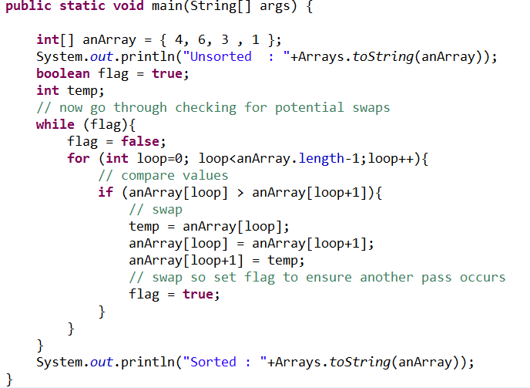
Sorting arrays – bubble sort in action

Slide 7
Bubble sort exercise
4 | 1 | 3 | 2
Notes:
Unsorted : [4, 1, 3, 2]
[1, 4, 3, 2]
[1, 3, 4, 2]
[1, 3, 2, 4]
End of pass [1, 3, 2, 4]
[1, 3, 2, 4]
[1, 2, 3, 4]
[1, 2, 3, 4]
End of pass [1, 2, 3, 4]
[1, 2, 3, 4]
[1, 2, 3, 4]
[1, 2, 3, 4]
End of pass [1, 2, 3, 4]
Sorted : [1, 2, 3, 4]

Slide 8
Selection sort
Simple, but inefficient, sorting algorithm.
The first iteration selects the smallest element in the array and swaps it with the first element.
The second iteration selects the second-smallest item (which is the smallest item of the remaining elements) and swaps it with the second element. The algorithm continues until the last iteration selects the second-largest element and swaps it with the second-to-last index, leaving the largest element in the last index.

Slide 9
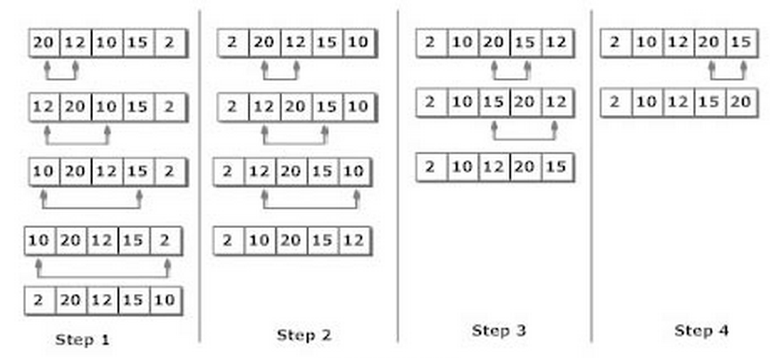
Selection sort
Notes:
http://www.youtube.com/watch?v=f8hXR_Hvybo

Slide 10
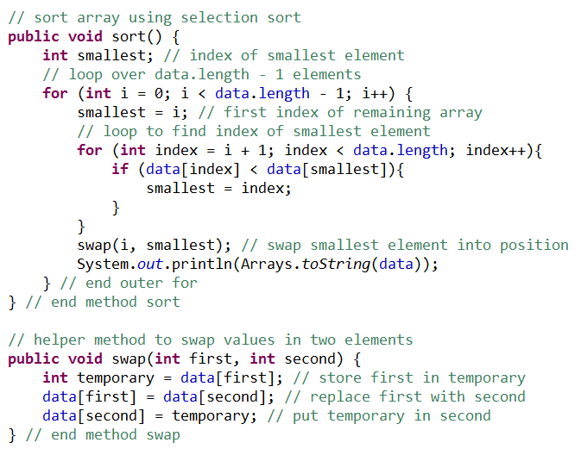
Selection sort implementation
Notes:
package sortingExamples;
import java.util.Arrays;
import java.util.Random;
public class SelectionSortArray {
private int[] data; // array of values
private static final Random generator = new Random();
public SelectionSortArray(int size) {
data = new int[size]; // create space for array
// fill array with random ints in range 1-20
for (int loop = 0; loop < size; loop++) {
data[loop] = generator.nextInt(50) + 1;
}
System.out.println(Arrays.toString(data));
}
public void selctionSort() {
int smallestIndex = 0; // index of the smallest value
int currentIndex = 0; // start point for loop
do { // loops once through the whole array
// set the smallest index pointer to the current loop iteration value
smallestIndex = currentIndex;
// go through each element left in the array to find the smallest element
for (int loop = currentIndex + 1; loop < data.length; loop++) {
// check if this the smallest value
if (data[loop] < data[smallestIndex]) {
smallestIndex = loop; // new smallest value
}
}
System.out.println("Smallest num " + data[smallestIndex]);
// swap
swap(data[currentIndex], data[smallestIndex]);
System.out.println(Arrays.toString(data));
// update the overall loop contol variable
++currentIndex;
} while (currentIndex < data.length); // end only at last value
}
// helper method to swap values in two elements
public void swap(int first, int second) {
int temporary = data[first]; // store first in temporary
data[first] = data[second]; // replace first with second
data[second] = temporary; // put temporary in second
} // end method swap
}

Slide 11
Efficiency of the Selection Sort
The selection sort algorithm runs in O(n2) time. The sort method implements the selection sort algorithm, contains two for loops.
The outer loop iterates over the first n – 1 elements in the array, swapping the smallest remaining item into its sorted position.
The inner for loop iterates over each item in the remaining array, searching for the smallest element. This loop executes n – 1 times during the first iteration of the outer loop, n – 2 times during the second iteration, then n – 3,…, 3, 2, 1. This inner loop will iterate a total of n(n – 1)/2 or (n2 – n)/2.
In Big O notation, smaller terms drop out and constants are ignored, leaving a final Big O of O(n2). Very poor efficiency.

Slide 12
Insertion sort
Another simple, but inefficient, sorting algorithm.
The first iteration of this algorithm takes the second element in the array and, if it’s less than the first element, swaps it with the first element.
The second iteration looks at the third element and inserts it into the correct position with respect to the first two, so all three elements are in order.
At the ith iteration of this algorithm, the first i elements in the original array will be sorted.

Slide 13
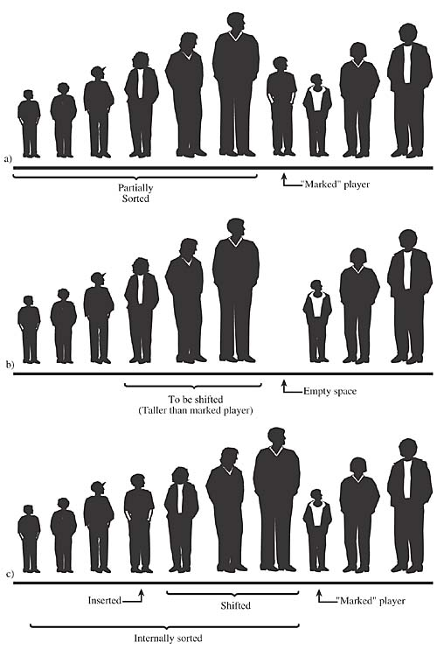
Insertion sort

Slide 14
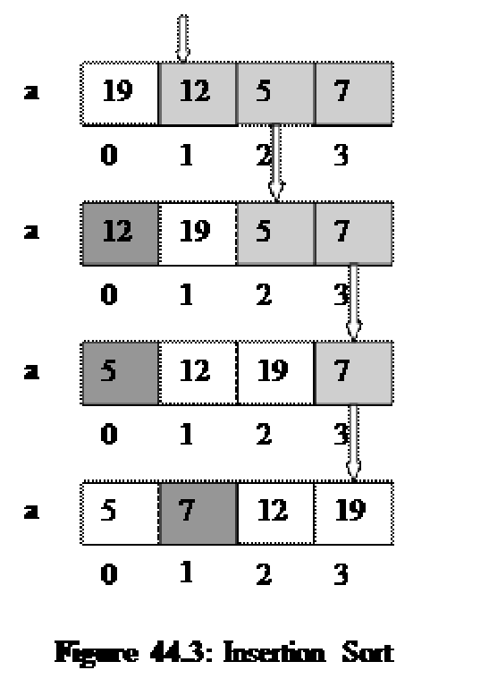
Insertion sort

Slide 15
Insertion Exercise
90 | 26 | 80 | 72
Notes:
[90, 26, 80, 72]
[26, 90, 80, 72]
[26, 80, 90, 72]
[26, 72, 80, 90]

Slide 16
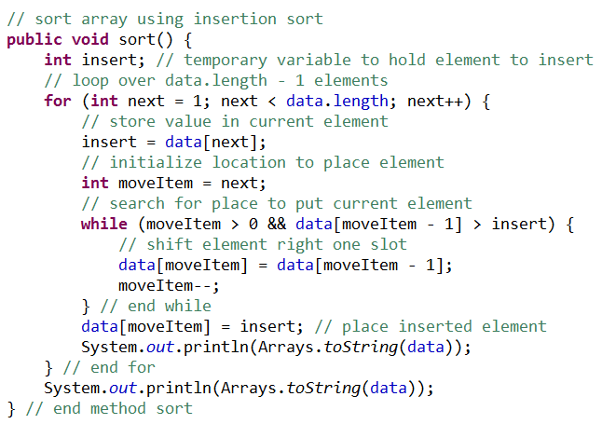
Insertion sort Implementation

Slide 17
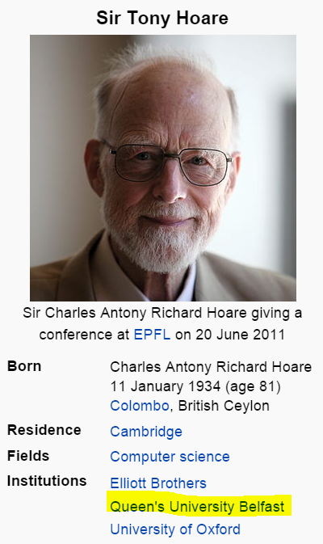
Quick Sort
Quicksort is a divide and conquer algorithm. In a divide and conquer sorting algorithm the original data is separated into two parts (divide) which are individually sorted (conquered) and then combined.
Invented by Tony Hoare.

Slide 18
Quick Sort
If the array contains only one element or zero elements then the array is sorted.
If the array contains more then one element then:
Select an element from the array. This element is called the "pivot element". For example select the element in the middle of the array or at the start.
All elements which are smaller then the pivot element are placed in one array and all elements which are larger are placed in another array.
Sort both arrays by recursively applying Quicksort to them.
Combine the arrays
Quicksort can be implemented to sort "in-place". This means that the sorting takes place in the array and that no additional array needs to be created.
Notes:
package sortingExamples;
import java.util.Arrays;
import java.util.Random;
public class QuickSort {
private int[] data; // array of values
private int number;
private static final Random generator = new Random();
public QuickSort(int size) {
data = new int[size]; // create space for array
// fill array with random ints in range 1-20
for (int loop = 0; loop < size; loop++) {
data[loop] = generator.nextInt(50) + 1;
}
System.out.println(Arrays.toString(data));
}
public void sort() {
// check for empty or null array
if (data == null || data.length == 0) {
System.out.println("Null or empty array");
return;
}
number = data.length;
quicksort(0, number - 1);
System.out.println(Arrays.toString(data));
}
private void quicksort(int low, int high) {
int i = low, j = high;
// Get the pivot element from the middle of the list
int pivot = data[low + (high - low) / 2];
// Divide into two lists
while (i <= j) {
// If the current value from the left list is smaller then the pivot
// element then get the next element from the left list
while (data[i] < pivot) {
i++;
}
// If the current value from the right list is larger then the pivot
// element then get the next element from the right list
while (data[j] > pivot) {
j--;
}
// If we have found a values in the left list which is larger then
// the pivot element and if we have found a value in the right list
// which is smaller then the pivot element then we exchange the
// values.
// As we are done we can increase i and j
if (i <= j) {
swap(i, j);
i++;
j--;
}
}
if (low < j)
quicksort(low, j); // Recursion
if (i < high)
quicksort(i, high); // Recursion
}
// helper method to swap values in two elements
public void swap(int first, int second) {
int temporary = data[first]; // store first in temporary
data[first] = data[second]; // replace first with second
data[second] = temporary; // put temporary in second
} // end method swap
}

Slide 19
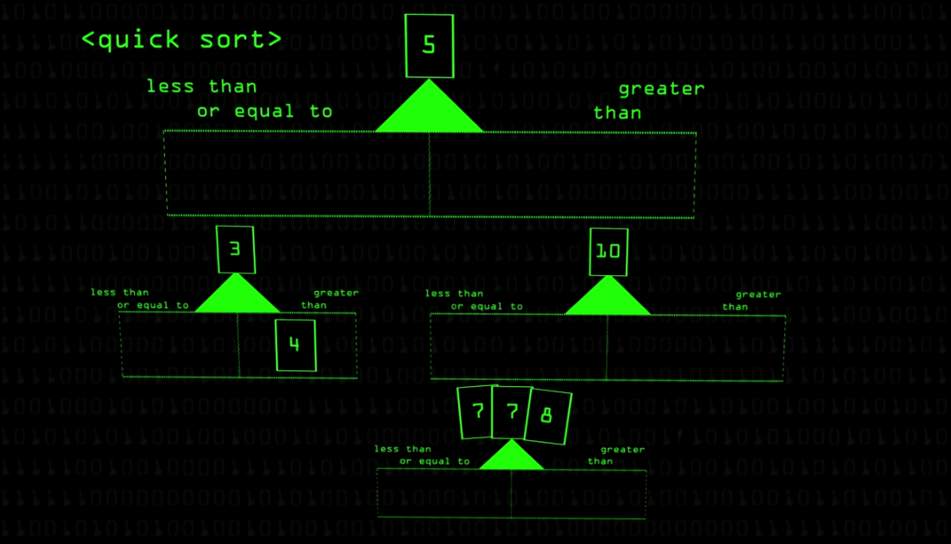
Notes:
https://www.youtube.com/watch?v=XE4VP_8Y0BU

